Slide 1


Dupilumab, an IgG4 Monoclonal Antibody for Eosinophilic Esophagitis: Revising the Treatment Paradigm
Original Article
Article covered: Dellon ES, Rothenberg MH, Collins I, et al. Dupilumab in adults and adolescents with eosinophilic esophagitis. N Engl J Med 2022; 387: 2317-30.
EBGI Summary

Slide 2
Study Question
Are weekly subcutaneous injections of dupilumab an anti-interleukin-4/13 monoclonal antibody, superior to placebo for inducing histologic remission and symptomatic improvement in swallowing for eosinophilic esophagitis (EoE) in adults (>18 years old) and adolescents (>12 to <18 years old)?

Slide 3
Why is This Important?
Efficacy of current treatment regimens for Eosinophilic esophagitis (EoE) such as PPIs, swallowed inhaled steroids and food elimination diets is limited by nonadherence
Dupilumab weekly subq use is the first FDA-approved tx for EoE
Dupilumab acts by inhibiting Type 2 Helper T-cell mediated inflammation

Slide 4




Study Design
Setting: 96 centers across Australia, Canada, Europe, and USA
Design: To assess induction of remission at 24 weeks, 2 multi-center, double-blind, placebo-controlled randomized controlled trials (RCTs) were conducted (Part A and Part B). A single multi-center, active treatment extension study through week 52 was also performed (Part C). Randomization was stratified for age (adolescent [>12 years and < 18 years old] vs adults [>18 years old]) and current use of proton pump inhibitors (PPIs).
Inclusion Criteria:
  >=12 years old
  Confirmed EOE (>=15 eosinophils per HPF after 8 weeks of high dose PPI)
  >10 on Dysphagia Symptom Questionnaire (DSQ)
Dupilumab 300mg SQ weekly
Placebo SQ weekly
Placebo SQ every 2 weeks
Dupilumab 300mg SQ every 2 weeks
Histologic Remission, Dysphagia symptom questionnaire, and endoscopic reference scoring system

Slide 5
Interventions
Study Design= RCT
Part A:
Dupilumab 300mg SQ weekly vs Placebo SQ weekly for 24 weeks
3 Parts to the study
In Part A, patients were randomized 1:1 to dupilumab 300 mg subcutaneous (subq) weekly vs placebo subq weekly for 24 weeks
In Part B, patients were randomized 1:1:1 to dupilumab 300 mg subq weekly vs dupilumab 300 mg subq every 2 weeks vs placebo subq every 2 weeks.
In Part C, where data is only available from patients who participated in Part A, all patients were treated with dupilumab 300 mg subq weekly for an additional 28 weeks (52 weeks total), regardless of whether they originally received dupilumab or placebo during Part A
Part B:
Dupilumab 300mg SQ weekly vs Dupilumab 300mg SQ every 2 weeks vs placebo SQ every 2 weeks for 24 weeks
Part C:
Dupilumab 300 mg SQ weekly for an additional 28 weeks (52 weeks)
regardless of whether they originally received dupilumab or placebo during Part A.

Slide 6
Outcomes & Definitions
Co-primary endpoints:
  histological remission (<=6 eosinophils per HPF)
  change in baseline Dysphagia Symptom Questionnaire (DSQ)
Secondary endpoints
  included absolute change from baseline in the endoscopic reference scoring system (EREFS)
    ranges 0-18 with higher scores indicating more severe endoscopic findings

Slide 7
Results
Histologic remission was significantly more common with dupilumab 300 mg subq weekly vs placebo in Part A (60% vs 5%) and Part B (59% vs 6%)
Dupilumab 300 mg subq weekly also produced significantly larger reductions from baseline in dysphagia symptoms per DSQ in Part A (68% vs 27%) and Part B (62% vs 38.5%)
Reduction in EREFS score was also greater with dupilumab 300 mg subq weekly vs placebo in Part A (-3.2 vs -0.3) and Part B (-4.5 vs -0.6)
In Part C, where all patients from Part A received dupilumab 300 mg subq weekly for an additional 28 weeks, histologic remission and reduction in DSQ was sustained among patients who originally received dupilumab and similar rates of histologic remission and reduction in DSQ were observed in patients switched from placebo to dupilumab

Slide 8
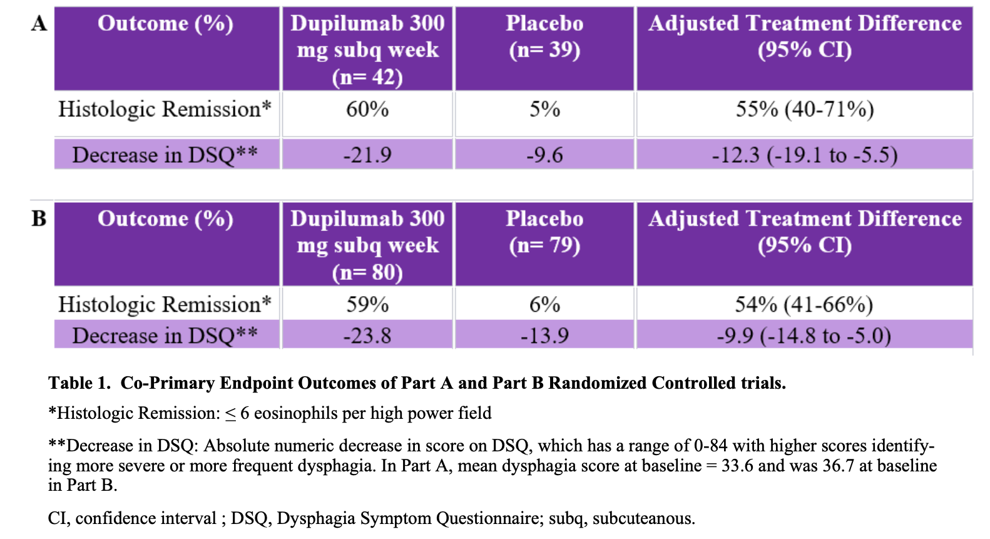

Slide 9
Key Study Findings
Histologic remission is significantly more common with Dupilumab weekly and every 2 weeks VS placebo in part A (60 vs 5%) and part B (59% vs 6%)
Dysphagia scores have a significantly larger reduction from baseline with Dupilumab weekly per DSQ in part A (68% vs 27%) and part B (62% vs 38.5%)
Dysphagia scores have NO statistically significant decrease with Dupilumab every 2 weeks dosing

Slide 10
Study Limitations
Efficacy in treatment-naïve patients is unknown
  Study patients had already tried PPIs and failed to get histologic remission or adequate relief of dysphagia, which is similar to other studies of EoE treatments
  Approximately 40% had used or were using food elimination diets at the onset of trial
Dupilumab is significantly more expensive than PPIs, food elimination diets or swallowing the content of corticosteroid metered dose inhalers
The study period of 52 weeks although a long period for a study, is still short for a chronic lifelong condition

Slide 11
How Should We Apply This to Our Practice?
Adhere to the quality indicators for diagnosis and management of EoE
  Obtain 6 biopsies from 2 different esophageal levels to evaluate dysphagia
  Obtain biopsies during food impactions if medically safe to do so
Repeat endoscopy after 3-4 months of starting a new treatment to assess for histologic remission
EoE is a chronic condition and requires lifelong treatment to minimize and prevent the risk of recurrent symptoms and fibrosis or stricturing in the esophagus

