Slide 1
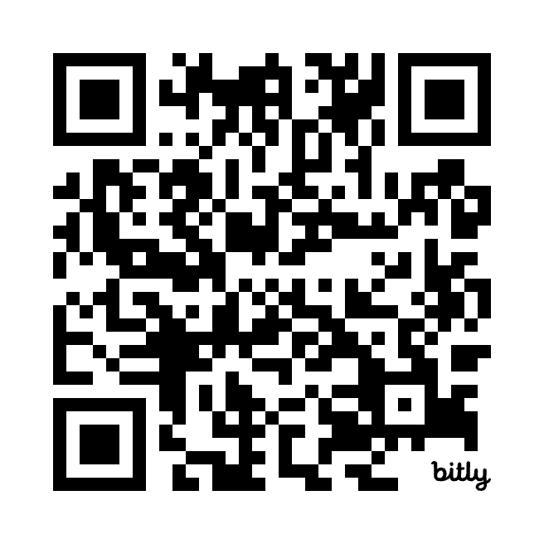
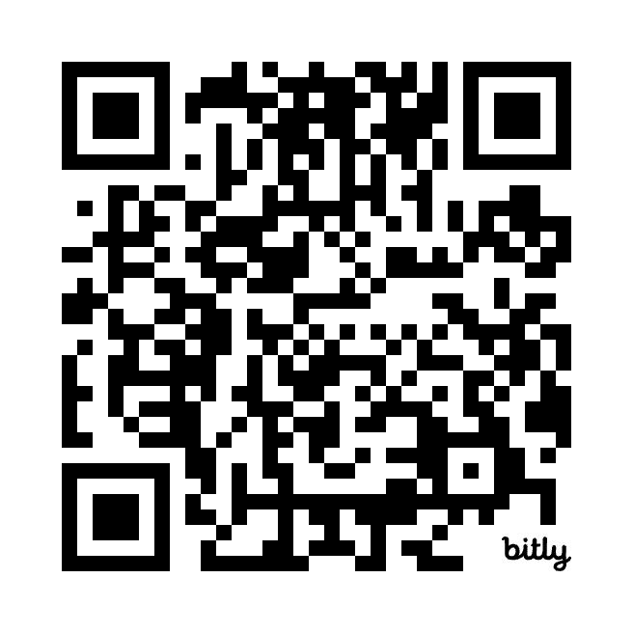
Risk of GI Adverse Events with GLP-1 Receptor Agonists for Weight Loss
Original Article
Article Covered: Sodhi M, Rezaeianzadeh R, Kezouh A, Etminan M. Risk of gastrointestinal adverse events associated with glucagon-like peptide-1 receptor agonists for weight loss. JAMA Medicine 2023; 330(18):1795-1797.
EBGI Summary

Slide 2
Study Question
Are glucagon-like peptide 1 (GLP-1) receptor agonists associated with an increased risk of biliary disease, pancreatitis, and other gastrointestinal (GI) adverse events?

Slide 3
Why is This Important?
GLP-1 receptor agonists have become popular in the media as a weight loss agent
GLP-1 receptor agonists have been implicated in delaying GI motility
As a result, gastroenterologists may be asked about the potential GI risks of these medications
Sodhi M et al. JAMA 2023;330(18):1795-1797. Schoenfeld P, Paul S. Evidence Based GI Nov 2023; 1-4.

Slide 4
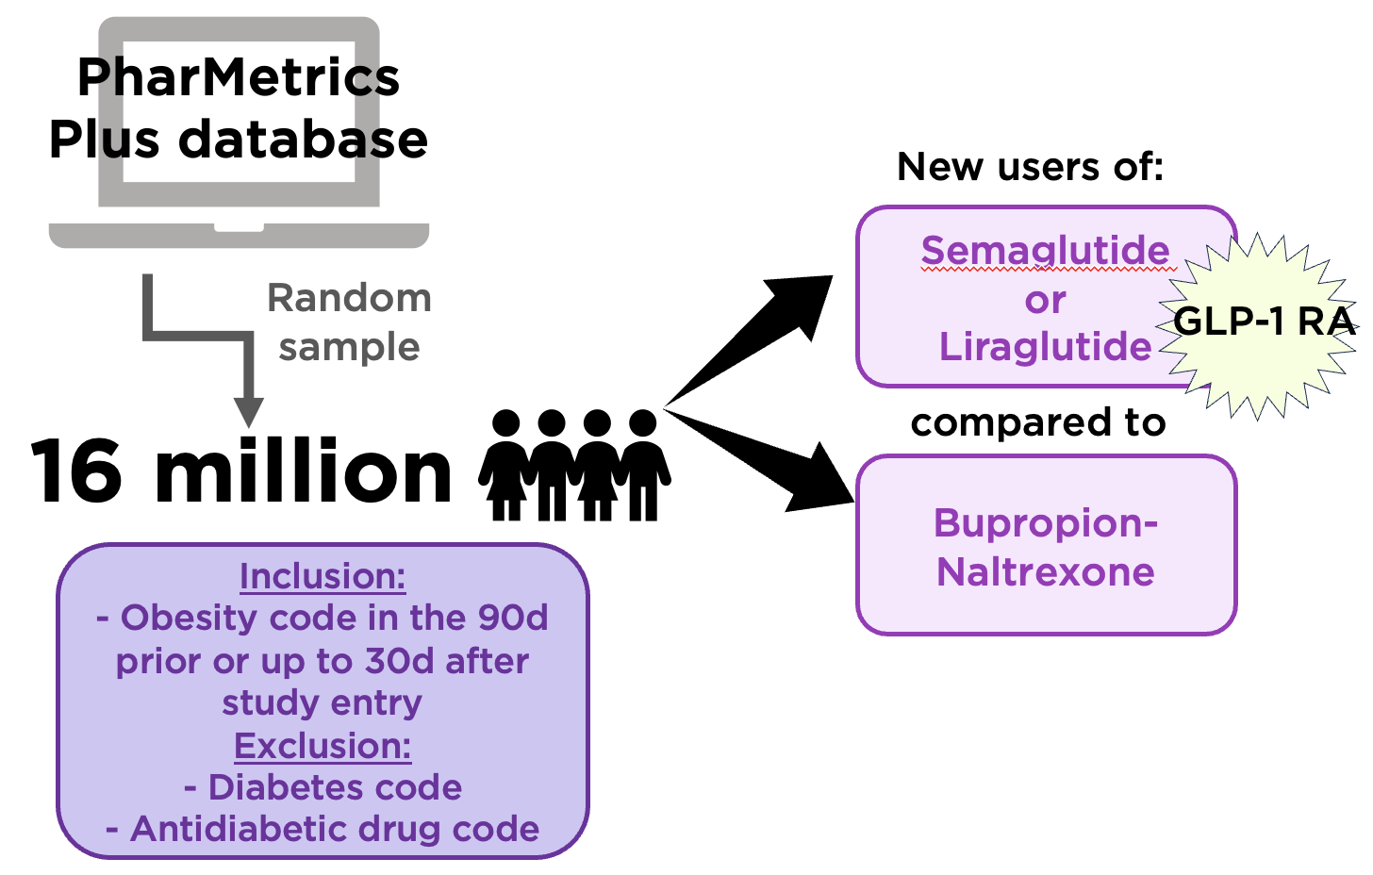
Study Design
Design: Retrospective cohort study
Setting: Random sample of 16 million patients (2006-2020) from PharMetrics Plus database, a large health claims database of outpatient prescriptions and ICD-9 and 10 diagnoses
Patients: New users of semaglutide and liraglutide vs bupropion-naltrexone
Sodhi M et al. JAMA 2023;330(18):1795-1797. Schoenfeld P, Paul S. Evidence Based GI Nov 2023; 1-4.

Slide 5
Interventions
Included new users of semaglutide and liraglutide, 2 GLP-1 receptor agonists used for diabetes
Users of bupropion-naltrexone served as the active comparator
Note: Because semaglutide was marketed for weight loss after the study period, investigators ensured all of the above users had an obesity code in the 90d prior up to 30d after cohort entry
Sodhi M et al. JAMA 2023;330(18):1795-1797. Schoenfeld P, Paul S. Evidence Based GI Nov 2023; 1-4.

Slide 6
Outcomes & Definitions
Patients in each group were observed from first prescription of medication to first mutually exclusive incidence (first ICD-9 or ICD-10 code) of:
  Biliary disease (cholecystitis, cholelithiasis, choledocholithiasis)
  Pancreatitis (including gallstone pancreatitis)
  Bowel obstruction
  Gastroparesis
…or to the end of the study period (June 2020)
Sodhi M et al. JAMA 2023;330(18):1795-1797. Schoenfeld P, Paul S. Evidence Based GI Nov 2023; 1-4.
Notes:
Hazard ratios (HR) calculated using Cox proportional hazards model after adjusting for age, sex, smoking, hyperlipidemia, geographic location, and abdominal surgery in the previous 30 days.
ICD-9, ICD-10: International Classification of Diseases, Ninth or Tenth Revision

Slide 7
Results
HR (95% CI)
Biliary disease
Pancreatitis
Bowel obstruction
Gastroparesis
1.50 (0.89-2.53)
Incidence rates for pancreatitis, bowel obstruction, and gastroparesis were significantly higher among users of GLP-1 agonists compared to bupropion-naltrexone users
9.09 (1.25-66.0)
4.22 (1.02-17.40)
3.67 (1.15-11.90)
Sodhi M et al. JAMA 2023;330(18):1795-1797. Schoenfeld P, Paul S. Evidence Based GI Nov 2023; 1-4.

Slide 8
Results
Incidence per 1,000 person-years (No. of patients)
 | Semaglutide | Liraglutide | Bupropion-Naltrexone
Biliary disease | 11.7 (5) | 18.6 (162) | 12.6 (16)
Pancreatitis | 4.6 (2) | 7.9 (71) | 1.0 (1)
Bowel obstruction | 0 | 8.1 (73) | 1.7 (2)
Gastroparesis | 9.1 (4) | 7.3 (66) | 3.1 (3)
Sodhi M et al. JAMA 2023;330(18):1795-1797. Schoenfeld P, Paul S. Evidence Based GI Nov 2023; 1-4.

Slide 9
Key Study Findings
Incidence rates for pancreatitis, bowel obstruction, and gastroparesis were significantly higher among users of GLP-1 agonists compared to bupropion-naltrexone users
Biliary disease was numerically higher, but did not achieve statistical significance in the primary analysis
Sodhi M et al. JAMA 2023;330(18):1795-1797. Schoenfeld P, Paul S. Evidence Based GI Nov 2023; 1-4.

Slide 10
Study Limitations
Semaglutide was not approved for weight loss until 2021, thus most users had diabetes, which may cause gastroparesis
Misclassification often occurs with ICD-9/ICD-10 coding
Data regarding the dose and duration of GLP-1 agonist use was not considered
Sodhi M et al. JAMA 2023;330(18):1795-1797. Schoenfeld P, Paul S. Evidence Based GI Nov 2023; 1-4.

Slide 11
How Should We Apply This to Our Practice?
How do you counsel patients who are recommended to start a GLP-1 agonist about the potential GI adverse effects of the medication?
If a patient taking a GLP-1 receptor agonist is experiencing nausea, vomiting, or abdominal discomfort, what recommendations might you provide?
Does this study influence your view on the anesthesiology guidelines to hold GLP-1 receptor agonists prior to endoscopic procedures?
Sodhi M et al. JAMA 2023;330(18):1795-1797. Schoenfeld P, Paul S. Evidence Based GI Nov 2023; 1-4.

