Slide 1


QR Code
Risankizumab, an IL-23 Inhibitor, for Moderate-Severe Crohn’s Disease
Original Article
QR Code
Article covered: D'Haens G, Panaccione R, Baert F, et al. Risankizumab as induction therapy for Crohn's disease: results from the phase 3 ADVANCE and MOTIVATE induction trials. Lancet. 2022;399(10340):2015-2030.
EBGI Summary

Slide 2
Study Question
Is Risankizumab, an interleukin (IL)-23 inhibitor, efficacious and safe for induction of remission in patients with moderate to severe Crohn’s disease?
D'Haens et al. Lancet. 2022;399(10340):2015-203. Kochar B. Evidence-Based GI January 2023: 1-7.

Slide 3
Why is This Important?
Prior biologics such as ustekinumab targeted the p40 subunit shared by both IL-12 and 23
Activation of IL-23 specifically triggers differentiation of naïve T-cells to produce pro-inflammatory cytokines and suppress regulatory T-cell activity
Risankizumab targets the p19 subunit unique to IL-23 and may confer added value to expanding therapeutics approved for Crohn’s disease
D'Haens et al. Lancet. 2022;399(10340):2015-203. Kochar B. Evidence-Based GI January 2023: 1-7.

Slide 4
Study Design
Design: Two multi-center, randomized, double-blind, placebo-controlled trials (ADVANCE and MOTIVATE)
Setting: 297 academic centers, research units and private practices from 44 countries between 2017-2020
Patients: Patients 16-80 years of age with moderate-severe Crohn’s with either CDAI 220—450, stool frequency ≥4 or abdominal pain score ≥2
D'Haens et al. Lancet. 2022;399(10340):2015-203. Kochar B. Evidence-Based GI January 2023: 1-7.

Slide 5
Interventions
Patients were randomized to 1 of 3 arms:
  Risankizumab 600 mg IV at week 0, 4 and 8
  Risankizumab 1200mg IV at week 0, 4 and 8
  Placebo at week 0, 4 and 8
  In ADVANCE trial, patients were randomized 2:2:1, while patients were randomized 1:1:1 in MOTIVATE trial
D'Haens et al. Lancet. 2022;399(10340):2015-203. Kochar B. Evidence-Based GI January 2023: 1-7.

Slide 6
Outcomes & Definitions
Primary Outcomes
  Clinical remission at 12 weeks
    Defined by: CDAI <150 (US) or abdominal pain score ≤1 and average daily stool frequency <2.8 (other countries)
  Endoscopic response at 12 weeks
D'Haens et al. Lancet. 2022;399(10340):2015-203. Kochar B. Evidence-Based GI January 2023: 1-7.

Slide 7
Efficacy Results - ADVANCE Trial
931 enrolled in ADVANCE trial (850 with primary efficacy endpoints)
Clinical remission defined by CDAI achieved:
  45% of patients receiving Risankizumab 600 mg IV
  41% in the 1200 mg IV group
  25% treated with placebo
Clinical remission by patient-reported outcomes achieved:
  43% in the Risankizumab 600 mg IV
  41% in the 1200 mg IV group
  19% treated with placebo
D'Haens et al. Lancet. 2022;399(10340):2015-203. Kochar B. Evidence-Based GI January 2023: 1-7.

Slide 8
Efficacy Results – MOTIVATE Trial
618 enrolled in MOTIVATE trial (569 with primary efficacy endpoints)
Clinical remission defined by CDAI achieved:
  42% of patients receiving Risankizumab 600 mg IV
  40% in the 1200 mg IV group
  21% treated with placebo
Clinical remission by patient-reported outcomes achieved:
  35% in the Risankizumab 600 mg IV
  40% in the 1200 mg IV group
  19% treated with placebo
D'Haens et al. Lancet. 2022;399(10340):2015-203. Kochar B. Evidence-Based GI January 2023: 1-7.

Slide 9
Safety Results
MOTIVATE trial had higher rates of week 12 endoscopic response compared to ADVANCE trial
Risankizumab shown to be minimally immunogenic with 1% of patients in ADVANCE and 2% in MOTIVATE developing anti-drug antibodies
Adverse events:
  Most frequently nasopharyngitis & headache in treatment arm
  Most frequently worsening IBD in placebo arm
  Two deaths in placebo arm, one death unrelated to medication in treatment arm
D'Haens et al. Lancet. 2022;399(10340):2015-203. Kochar B. Evidence-Based GI January 2023: 1-7.

Slide 10
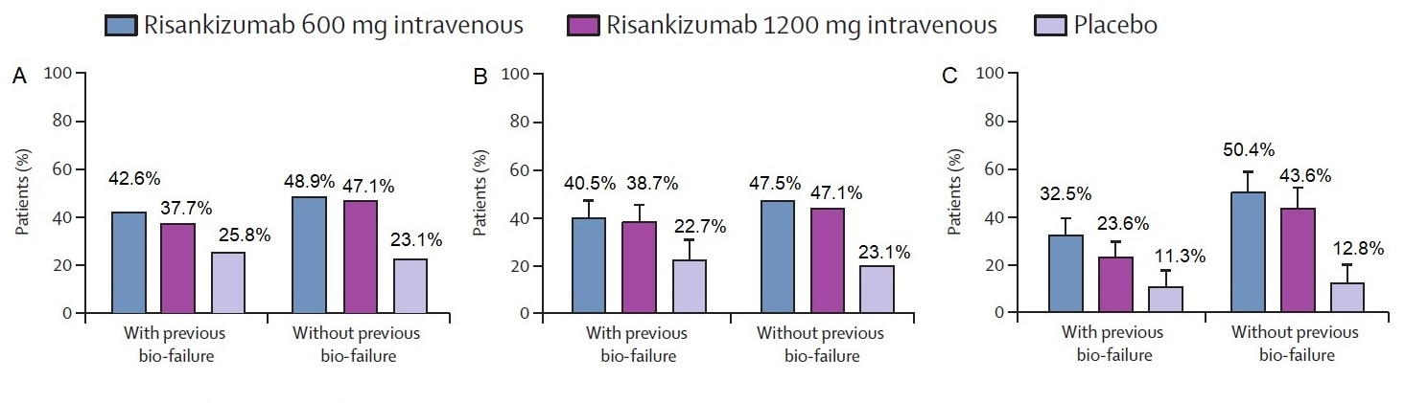
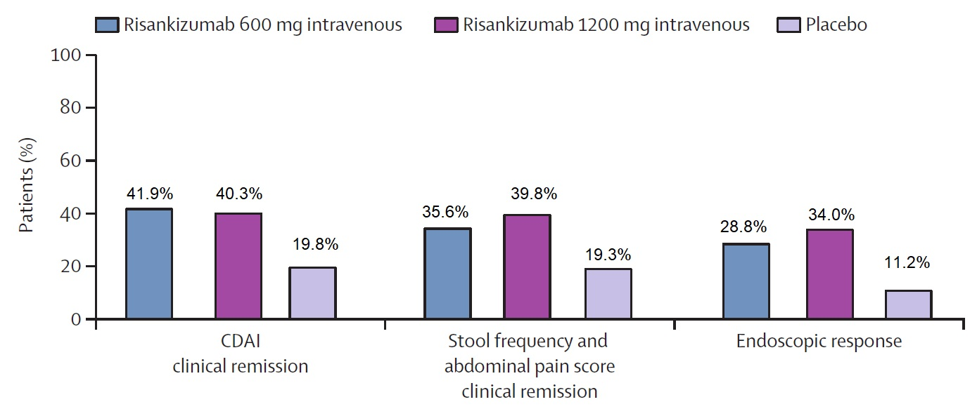
Results
ADVANCE Trial: Coprimary endpoints at week 12
MOTIVATE Trial: Coprimary endpoints at week 12
(A) CDAI clinical remission
(B) Stool frequency and abdominal pain score clinical remission
(C) Endoscopic response
D'Haens et al. Lancet. 2022;399(10340):2015-203. Kochar B. Evidence-Based GI January 2023: 1-7.

Slide 11
Study Limitations
Adverse events were similar among all treatment groups, but prescribing information for risankizumab notes that drug-induced liver injury has been reported
Paucity of data for efficacy for small intestinal inflammation, strictures, and peri-anal disease
Exclusion of pregnant women – no safety data available
No insight into positioning therapeutics (i.e., which anti-interleukin should be first-line)
Kochar B. Evidence-Based GI January 2023: 1-7.

Slide 12
How Should We Apply This to Our Practice?
Should risankizumab be used as a first-line agent instead of ustekinumab?
Should we start anti-interleukin agents in patients who have perianal fistulizing Crohn’s disease? If so, when?
Should we start anti-interleukin agents in patients who have extraintestinal manifestations of Crohn’s disease?
Kochar B. Evidence-Based GI January 2023: 1-7.

