Slide 1


QR Code
Obesity Medications for reducing Hepatic decompensation in MASH
Original Article
QR Code
Article covered: Engström A, Wintzell V, Melbye M, et al. Association of glucagon-like peptide-1 receptor agonists with serious liver events among patients with type 2 diabetes: A Scandinavian cohort study. Hepatology. 2024 Jun 1;79(6):1401-1411
EBGI Summary

Slide 2
Study Question
Is use of GLP-1 receptor agonists use associated with reduced risk of serious liver end points in patients with MASH?

Slide 3
Why is This Important?
MASLD is a leading cause of cirrhosis and an important cause of hepatocellular carcinoma
Patients with MASLD and diabetes are at increased risk of complications and mortality has increased over the last decade
In clinical trials, GLP-1s have shown improvement in liver markers, resolution of steatohepatitis and delayed progression of fibrosis but data on hepatic endpoints remain unclear.
This study evaluates hepatic endpoints in patients taking GLP-1s

Slide 4
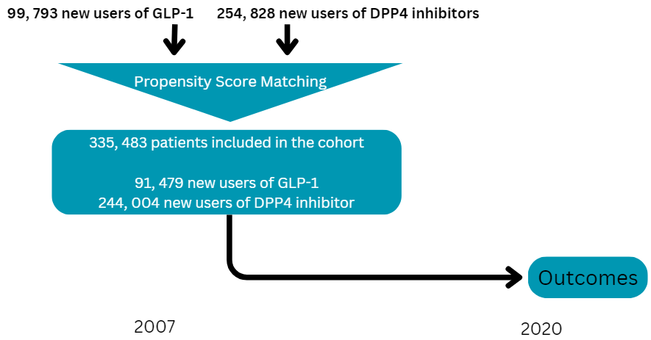
Study Design
Design: Cohort study with active-comparator new-user design
Setting: Nationwide health and administrative registers in Sweden, Denmark and Norway from January 2007 – December 2020
Patients: 91,479 new GLP-1 and 244,004 new DPP-4 users
Yeh, J. G., & Newsome, P. N. (2024). Association of glucagon-like peptide-1 receptor agonists with serious liver events among patients with type 2 diabetes: A Scandinavian cohort study. Hepatology (Baltimore, Md.), 79(6), 1255–1257. https://doi.org/10.1097/HEP.0000000000000768
Schoenfeld, P. (2024, April 23). How effective are obesity medications for reducing hepatic decompensation in Nash?. American College of Gastroenterology. https://gi.org/journals-publications/ebgi/schoenfeld2_april2024/

Slide 5
Interventions
New use of GLP-1 receptor agonist or DPP4 inhibitor between 2007 and December 2020.
Follow-up from treatment initiation until first occurrence of:
  Emigration,
  Death,
  Initiation of GLP-1 for patients who entered the study with DPP4 or vice versa,
  End of study period or
  Occurrence of study outcome
Yeh, J. G., & Newsome, P. N. (2024). Association of glucagon-like peptide-1 receptor agonists with serious liver events among patients with type 2 diabetes: A Scandinavian cohort study. Hepatology (Baltimore, Md.), 79(6), 1255–1257. https://doi.org/10.1097/HEP.0000000000000768
Schoenfeld, P. (2024, April 23). How effective are obesity medications for reducing hepatic decompensation in Nash?. American College of Gastroenterology. https://gi.org/journals-publications/ebgi/schoenfeld2_april2024/

Slide 6
Outcomes & Definitions
Primary endpoint: Composite serious liver events including
  Compensated and decompensated cirrhosis, and
  Hepatocellular carcinoma
Secondary endpoints included
  Compensated and decompensated cirrhosis
  Hepatocellular carcinoma
Compensated and decompensated cirrhosis include liver cirrhosis, esophageal varices with or without bleeding, hepatorenal syndrome, portal hypertension, liver failure, and liver transplantation.
Yeh, J. G., & Newsome, P. N. (2024). Association of glucagon-like peptide-1 receptor agonists with serious liver events among patients with type 2 diabetes: A Scandinavian cohort study. Hepatology (Baltimore, Md.), 79(6), 1255–1257. https://doi.org/10.1097/HEP.0000000000000768
Schoenfeld, P. (2024, April 23). How effective are obesity medications for reducing hepatic decompensation in Nash?. American College of Gastroenterology. https://gi.org/journals-publications/ebgi/schoenfeld2_april2024/

Slide 7
Results
Patients had a mean age of 62 years
Mean follow up time was 3-3.6yrs
0.6% of the patients had already been diagnosed with NASH/NAFLD at study inception
91,479 patients were new users of GLP-1 agonists
  81% used Oral Liraglutide
  4% used Subcutaneous Semaglutide
  21% of new GLP1 receptor agonists users also a carried a diagnosis of obesity
244,004 patients were new users of DPP4 inhibitors
  73% of patients used Sitagliptin
  8.4% of new DPP4 inhibitor users also carried a diagnosis of obesity
Yeh, J. G., & Newsome, P. N. (2024). Association of glucagon-like peptide-1 receptor agonists with serious liver events among patients with type 2 diabetes: A Scandinavian cohort study. Hepatology (Baltimore, Md.), 79(6), 1255–1257. https://doi.org/10.1097/HEP.0000000000000768
Schoenfeld, P. (2024, April 23). How effective are obesity medications for reducing hepatic decompensation in Nash?. American College of Gastroenterology. https://gi.org/journals-publications/ebgi/schoenfeld2_april2024/

Slide 8
Results
GLP-1 receptor agonists users had 16.9 serious liver events per 10,000 person years
DPP4 inhibitor users had 19.1 serious liver events per 10,000 person years
GLP-1 receptor agonists users had less compensated or decompensated cirrhosis compared to those on DPP4 inhibitors (aHR 0.85; 95% CIs 0.75-0.97)
No difference in HCC was demonstrated between groups

Slide 9
Key Study Findings
GLP-1 receptor agonists users had 16.9 serious liver events per 10,000 person years
DPP4 inhibitor users had 19.1 serious liver events per 10,000 person years
GLP-1 receptor agonists users had less compensated or decompensated cirrhosis compared to those on DPP4 inhibitors (aHR 0.85; 95% CIs 0.75-0.97)
There was no difference in HCC was shown between groups
In this observational study, patients with Type 2 DM who were treated with GLP-1 receptor agonists were less likely to develop serious liver events compared to patients receiving DPP4 inhibitors (aHR 0.85; 95% CIs 0.75-0.97).
Yeh, J. G., & Newsome, P. N. (2024). Association of glucagon-like peptide-1 receptor agonists with serious liver events among patients with type 2 diabetes: A Scandinavian cohort study. Hepatology (Baltimore, Md.), 79(6), 1255–1257. https://doi.org/10.1097/HEP.0000000000000768
Schoenfeld, P. (2024, April 23). How effective are obesity medications for reducing hepatic decompensation in Nash?. American College of Gastroenterology. https://gi.org/journals-publications/ebgi/schoenfeld2_april2024/
References

Slide 10
Study Limitations
Most patients on GLP-1 receptor agonists got Liraglutide PO, which hasn’t shown the weight loss impact of Semaglutide
There was no assessment of MASH/MASLD at baseline or changes in weight over time
Fewer than 1% of patients had confirmed MASH/MASLD during study inception
This study was limited to patients with Type 2 DM; the ideal population would be patients with MASH.
Yeh, J. G., & Newsome, P. N. (2024). Association of glucagon-like peptide-1 receptor agonists with serious liver events among patients with type 2 diabetes: A Scandinavian cohort study. Hepatology (Baltimore, Md.), 79(6), 1255–1257. https://doi.org/10.1097/HEP.0000000000000768
Schoenfeld, P. (2024, April 23). How effective are obesity medications for reducing hepatic decompensation in Nash?. American College of Gastroenterology. https://gi.org/journals-publications/ebgi/schoenfeld2_april2024/
References

Slide 11
How Should We Apply This to Our Practice?
How do we remain conscientious about medication coverage, availability and costs for our patients?
What can we do to aid patients in medication adherence and limit side effects that might push them towards discontinuing the medication too soon?
What dietary and lifestyle recommendations can we offer?
References

