Slide 1


Ustekinumab and Vedolizumab During Pregnancy in Patients with IBD-Updates from PIANO Registry
Original Article
QR Code
Article covered: This summary reviews Chugh R, Long MD, Jiang Y, et al. Maternal and neonatal outcomes in vedolizumab and ustekinumab exposed pregnancies: Results from the PIANO registry. Am J Gastroenterol. 2024; 119(3):468-476.
EBGI Summary

Slide 2
Study Question
Are ustekinumab (IL-23 monoclonal antibody) and vedolizumab (anti-integrin monoclonal antibody) safe during pregnancy in patients with IBD?

Slide 3
Why is This Important?
Prior data from PIANO registry showed that corticosteroid use in IBD patients during pregnancy is associated with increased adverse maternal & fetal outcomes, and anti-TNF and thiopurine during pregnancy were safe
Until this updated analysis, prior studies of ustekinumab (UST) and vedolizumab (VDZ) in pregnancy were limited due to small sample sizes
This prospective study is the largest study assessing maternal & infant outcomes after use of UST or VDZ

Slide 4




Study Design
Design: Multicenter, prospective, observational
Setting: PIANO registry, enrolled patients from >30 centers in the USA since 2007 (current study provides an updated analysis through 11/2022)
Patients: 1,669 completed pregnancies in patients with IBD

Slide 5




Interventions
Pregnant patients with IBD on medications including UST, VDZ, anti-TNF agents, immunomodulators, combination anti-TNF/thiopurine therapy, and no exposure to biologics or thiopurines
Questionaries were administered at study intake, each subsequent trimester, delivery, and 4, 9, 12 months after birth

Slide 6
Outcomes & Definitions
Primary outcomes
  Congenital malformations
  Spontaneous abortion
  Preterm birth
  C-section
  Small for gestational age
  Low birth weight
  NICU stay
  Intrauterine growth restriction
  Placental events
  Neonatal/infant infections
  Infant developmental milestones
Bivariate analyses to determine independent effects of specific drug classes on outcomes
Exposure cohorts were UST, VDZ, anti-TNF, immunomodulators, and anti-TNF and immunomodulators
All compared with no exposure to biologics/immunomodulators

Slide 7
Results
1,669 completed pregnancies in IBD with 1,610 resulting in a birth of a baby
  Mean maternal age: 32 years
  IBD duration: 8.5 years
  Disease type: 62% Crohn’s disease, 35% Ulcerative colitis, 2% unclassified
  Mean total pregnancies, including current: 2.1

Slide 8
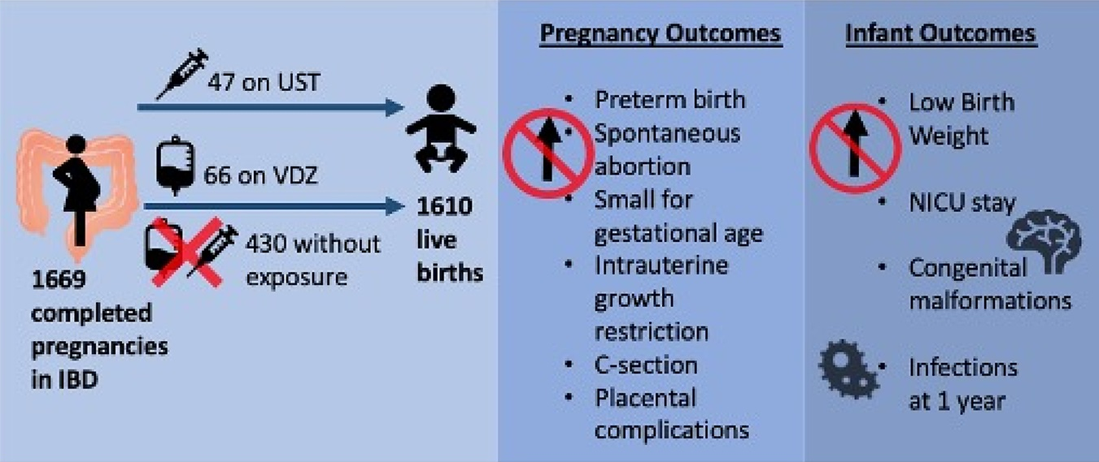
Results

Slide 9
Key Study Findings
No observed increased risk in congenital malformations, spontaneous abortion, small for gestational age, low birth weight, NICU stay, placental complications, or IUGR with either UST or VDZ compared to other therapy exposures
UST was associated with a lower rate of pre-term birth compared to all other therapies including VDZ
Infant infections in the first year of life were comparable by drug class, but lower non-serious infections in children with in utero UST exposure

Slide 10
Study Limitations
The study is a relatively small study with 113 patients exposed to either UST or VDZ, which can lead to type 2 error
Findings of study are based on patient questionaries (subject to selection, sampling, and recall bias)

Slide 11
How Should We Apply This to Our Practice?
How to implement findings of PIANO registry in patients with IBD contemplating pregnancy and need to initiate biologic therapy?
Given the lower rate of pre-term birth and non-serious infections in the first year in infants who exposed to UST in utero in this study, would this change your practice choosing UST over VDZ?

